Slide 1
The Manufacturing Process ECE4140/6240
Class 2
M. E. Zaghloul
Fall 23

Slide 2
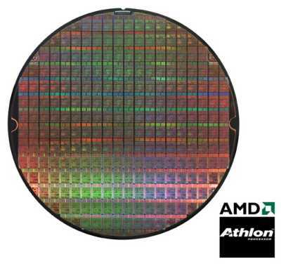
Integrated Circuits Fabrication The Wafer
Single die
Wafer
Going up to 12” (30cm)

Slide 3
Die Cost Is Going Down
Single die
Wafer
Going up to 12”
From http://www.amd.com

Slide 4
Cost per Transistor
cost:
¢-per-transistor
1
Fabrication capital cost per transistor (Moore’s law)
0.1
0.01
0.001
0.0001
0.00001
0.000001
0.0000001
1982
1985
1988
1991
1994
1997
2000
2003
2006
2009
2012

Slide 5
Yield

Slide 6
Defects
⍶ is parameter that depends on the complexity
of the fabrication roughly proportional to the number of masks

Slide 7
STEPS of Fabrications
In the next part we will discuss the most important steps of the fabrication
Please note that the fabrication is done by deposition of materials layer by layer of the different materials used in IC chips-mostly thin film
Thus we should be able to deposit and to etch ( remove) material with the structure we want.

Slide 8
Quiz
why do we have to understand the fabrication process as CMOS designer?

Slide 9
For CMOS technology we start from Silicon Wafer Preparation
Obtaining the Sand to grow the wafers has to be very clean and good form of silicon
The Sand is heated to about 1600 degree C where it melt
A pure Silicon seed Crystal is placed into the molten sand bath. This crystal will be pulled slowly while it rotate. The result is called ingot ( single crystal silicon) ( what is crystal?)

Slide 10
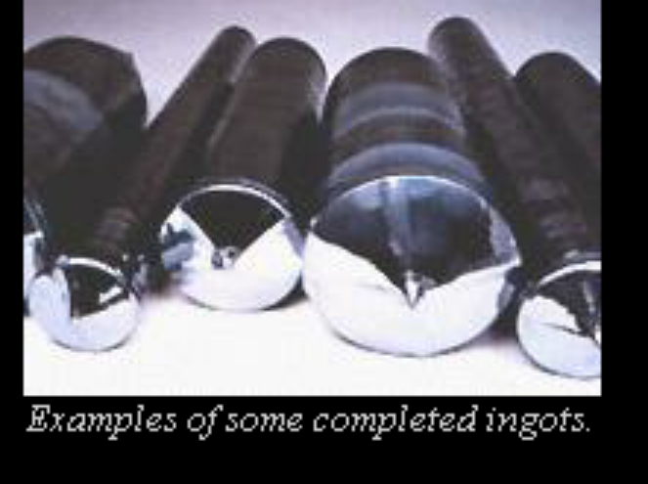
Example of some completed ingots

Slide 11
Important Steps in IC Silicon Fabrication Processing
Oxidation ( to form the silicon Oxide)
Photolithography to pattern the material
Etching to remove material( thin layer)
Depositions deposit material ( thin layer)
Separate course ECE4145 clean room experience, visit the GWU clean room( at the Basement of the SEH )

Slide 12
Let us Study each Step
The above listed steps are the basic steps of the clean room fabrication

Slide 13
Oxidation
Oxidation refer to the process of growing a layer of silicon dioxide onto the wafer surface. This layer is important for two purposes
The silicon oxide is an insulator to electricity. We want to isolate semiconductor transistors to achieve the correct parameters

Slide 14
Photolithography
It is the selective method for applying thin film materials to the wafer-
First thin film of the desired material is deposited on the whole wafer
Photoresist material is applied on the whole surface of the wafer
Light is shine through a mask then the photoresist is developed and removed Selectively

Slide 15
Silicon Wafer and
Thin film of material-green
Photoresist is applied-red
UV Light
Mask you the designer

Slide 16
Develop PR and etch
Patterned thin film

Slide 17
Etching
Chemical etching is to remove materials selectively from the areas of the wafer
Mostly acid is used to remove thin film selectively

Slide 18
Deposition
It is the process of depositing a thin film onto the surface of the wafer, the films are Aluminum, or copper, and many other metals.
Most common is the Chemical Vapor Deposition CVD
Low Pressure CVD is done in a vacuum in temp. 300-1250 C. The process deposit high temp oxides, polysilicon, or silicon nitride as thin film with excellent purity

Slide 19
Ion Implantation
Deposition and diffusion to produce N and P- wells, N+,P+ diffusion
N+, P+ define where areas of thin oxide are needed to implement transistor gate and allow implantation to form p- or n- type diffusion for source /drain

Slide 20
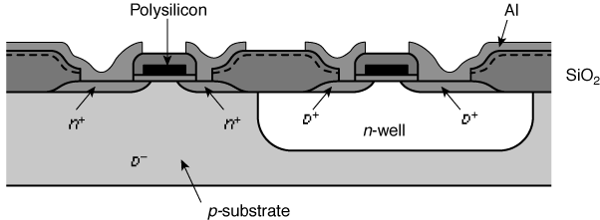
Cross-Section of CMOS Technology
Side View of Inverter

Slide 21
CMOS Fabrication Sequence
START P-type wafer bulk
Epitaxial Growth p-epi is used as base layer for building the devices
n-Well Formation the p-channel PMOS must reside in n-type background usually biased at Vdd to insure proper operation
P-epi
P⁺type

Slide 22
CMOS Fab (cont.)
n-well for PMOS transistor for the proper biasing
PMOS
NMOS
p-substrate
n-well

Slide 23
CMOS Fabrication (cont.)
Active area and Isolation , active area is a planar section of the surface where transistors are placed. Isolation regions surround the active areas and constitute the majority of the surface it is called Field Oxide
Interconnect lines such as polysilicon or metals are routed over the Isolations regions allowing us to route transistors and have circuits.

Slide 24
CMOS Process

Slide 25
Modern CMOS Process
n-well, p-well, twin-well process, several wells process
Several layers of metals, Al, Cu, and many other metals
Metal contacts are called Via ( metal to metal)
Silicon oxide is an insulator
Metals wirings are called interconnect

Slide 26
A Modern CMOS Process
Dual-Well Trench-Isolated CMOS Process

Slide 27
Circuit Under Design

Slide 28
Well and Substrate Taps
Substrate must be tied to GND and n-well to V_{DD} . Substrate must be biased ( connected to the right voltage) and wells must be biased.
Metal to lightly-doped semiconductor forms poor connection called Schottky Diode
Use heavily doped well and substrate contacts / taps
Remember for invertor the source of the n-transistor is connected to ground and the source of the p-type transistor is connected to VDD

Slide 29
Inverter Mask Set
Transistors and wires are defined by masks
Cross-section taken along dashed line

Slide 30
Detailed Mask Views
Six masks
n-well
Polysilicon
n+ diffusion
p+ diffusion
Contact
Metal

Slide 31
Example-Inverter Fabrication Steps
Start with blank wafer
Build inverter from the bottom up
First step will be to form the n-well
Cover wafer with protective layer of SiO₂ (oxide)
Remove layer where n-well should be built
Implant or diffuse n dopants into exposed wafer
Strip off SiO₂

Slide 32
To cover with thin layer of Silicon Oxide (Oxidation)
Grow SiO₂ on top of Si wafer
900 – 1200 C with H₂O or O₂ in oxidation furnace

Slide 33
Photoresist
Spin on photoresist
Photoresist is a light-sensitive organic polymer
Softens where exposed to light

Slide 34
Lithography
Expose photoresist through n-well mask
Strip off exposed photoresist

Slide 35
Etch
Etch oxide with hydrofluoric acid (HF)
Only attacks oxide where resist has been exposed

Slide 36
Strip Photoresist
Strip off remaining photoresist
Use mixture of acids called piranha etch
Necessary so resist doesn't’t melt in next step

Slide 37
n-Well
n-well is formed with diffusion or ion implantation
Diffusion
Place wafer in furnace with arsenic gas
Heat until atoms diffuse into exposed Si
Ion Implantation
Blast wafer with beam of ions
Ions blocked by SiO₂, only enter exposed Si

Slide 38
Strip Oxide
Strip off the remaining oxide using HF acid
Back to bare wafer with n-well
Subsequent steps involve similar series of steps

Slide 39
Polysilicon
Deposit very thin layer of gate oxide
< 20 Å (6-7 atomic layers)
Chemical Vapor Deposition (CVD) of silicon layer
Place wafer in furnace with Silane gas (SiH₄)
Forms many small crystals called polysilicon
Heavily doped to be good conductor

Slide 40
Polysilicon Patterning
Use same lithography process to pattern polysilicon

Slide 41
Self-Aligned Process
Use oxide and masking to expose where n+ dopants should be diffused or implanted
N-diffusion forms nMOS source, drain, and n-well contact

Slide 42
n-Diffusion
Pattern oxide and form n+ regions
Self-aligned process where gate blocks diffusion
Polysilicon is better than metal for self-aligned gates because it doesn't’t melt during later processing

Slide 43
n-Diffusion (cont’d.)
Historically dopants were diffused
Usually ion implantation today
But regions are still called diffusion

Slide 44
n-Diffusion (cont’d.)
Strip off oxide to complete patterning step

Slide 45
p-Diffusion
Similar set of steps form p+ diffusion regions for pMOS source and drain and substrate contact

Slide 46
Contacts
Now we need to wire together the devices
Cover chip with thick field oxide
Etch oxide where contact cuts are needed

Slide 47
Metallization
Sputter on aluminum over whole wafer
Pattern to remove excess metal, leaving wires

Slide 48
CMOS Process at a Glance
Define active areas
Etch and fill trenches
Implant well regions
Deposit and pattern
polysilicon layer
Implant source and drain
regions and substrate contacts
Create contact and via windows
Deposit and pattern metal layers

Slide 49
Layout
Chips are specified with set of masks designed by the Engineers of IC knowledge
Minimum dimensions of masks determine transistor size (and hence speed, cost, and power)
Feature size f = distance between source and drain
Set by minimum width of polysilicon
Feature size improves 30% every 3 years or so till today?
Normalize for feature size when describing design rules
Express rules in terms of λ = f/2
E.g. λ = 0.3 μm in 0.6 μm process

Slide 50
Layout Design Rules
λ parameter is popular scalable design rule generally half the minimum width of the polysilicon wire
Lambda based design rules are very conservative
It makes scaling simple
Lambda is half the feature size
Beyond 180nm design rules are more complicated

Slide 51
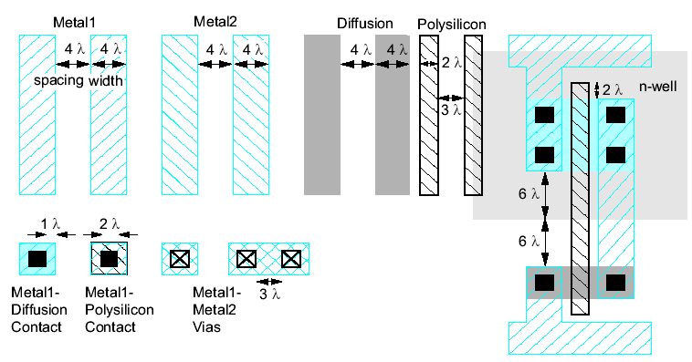
Simplified Design Rules Basic CMOS design
Conservative rules to get you started

Slide 52

Its Layout View

Slide 53
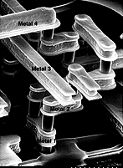
Advanced Metallization

Slide 54
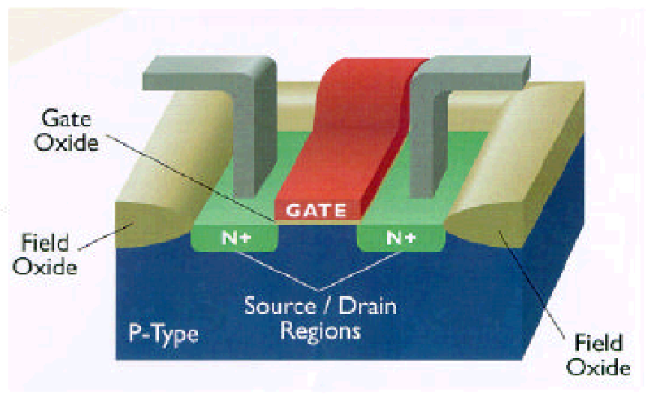
3D Perspective
Polysilicon
Aluminum

Slide 55
CMOS Process Layers
Layer
Color
Representation
Well (p,n)
Yellow
Active Area (n+,p+)
Green
Select (p+,n+)
Green
Polysilicon
Red
Metal1
Blue
Metal2
Magenta
Contact To Poly
Black
Contact To Diffusion
Black
Via
Black

Slide 56
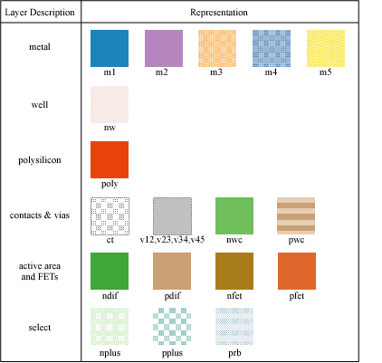
Layers in 0.25 μm CMOS process

Slide 57
Design Rules
Interface between designer and process engineer
Guidelines for constructing process masks
Unit dimension: Minimum line width
scalable design rules: lambda parameter
absolute dimensions (micron rules)

Slide 58
Intra-Layer Design Rules
4
Metal2
3

Slide 59
Transistor Layout
Poly
N-diffusion

Slide 60
Vias and Contacts Metal blue, Purple

Slide 61
CMOS Inverter Layout

Slide 62
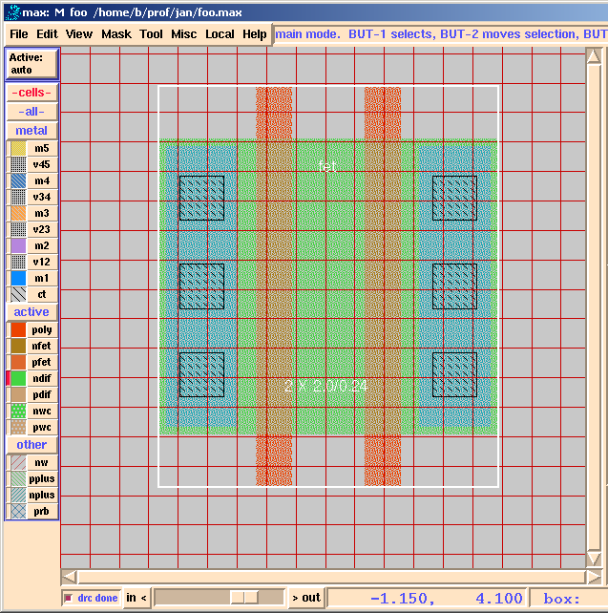
Layout Editor

Slide 63

Design Rule Checker built in CADENCE
poly_not_fet to all_diff minimum spacing = 0.14 um.

Slide 64
Circuit Layout

Slide 65
Circuit Under Design
This two-inverter circuit (of Figure 3.25 in the text) will be
manufactured in a twin-well process.

Slide 66
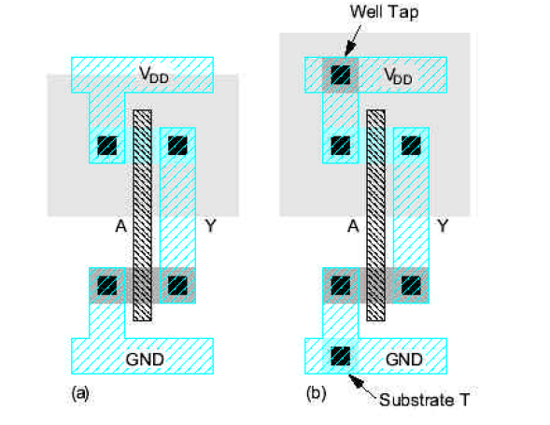
CMOS INVERTER

Slide 67
Rules for layout
Every well should have at least one tap
All substrate and well taps should connect directly to the appropriate power supply in metal
Taps should be placed every 5-10 transistors in the wells and on substrate
Place well taps adjacent to the power supply VDD, VGND
NMOS transistors should cluster together near GND line, PMOS transistors should cluster together near VDD
You always design as if you have double wells

Slide 68
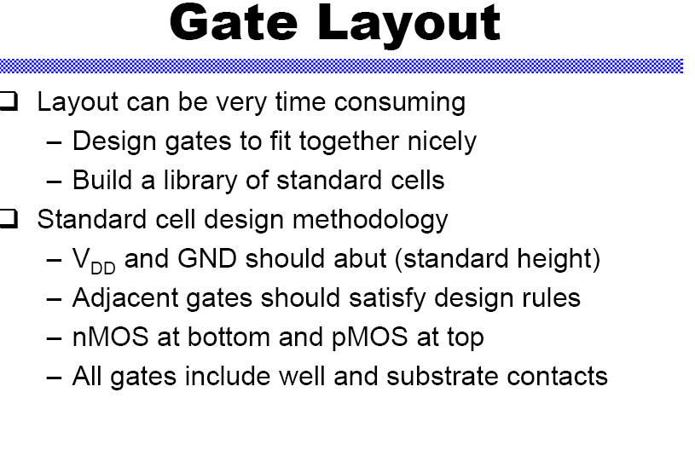

Slide 69
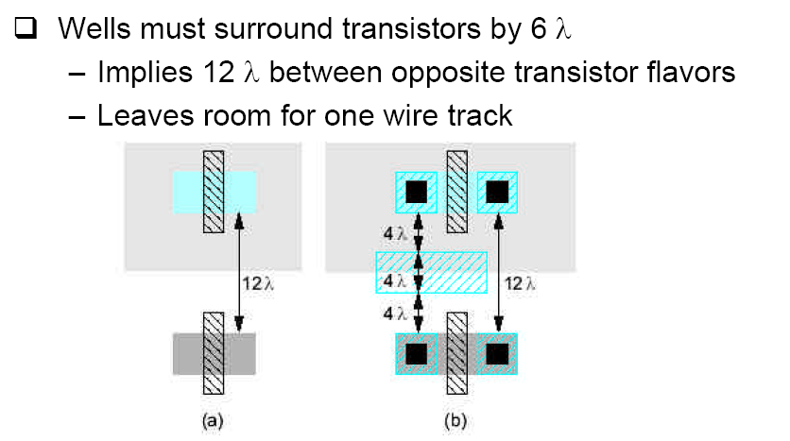
Well Spacing

Slide 70
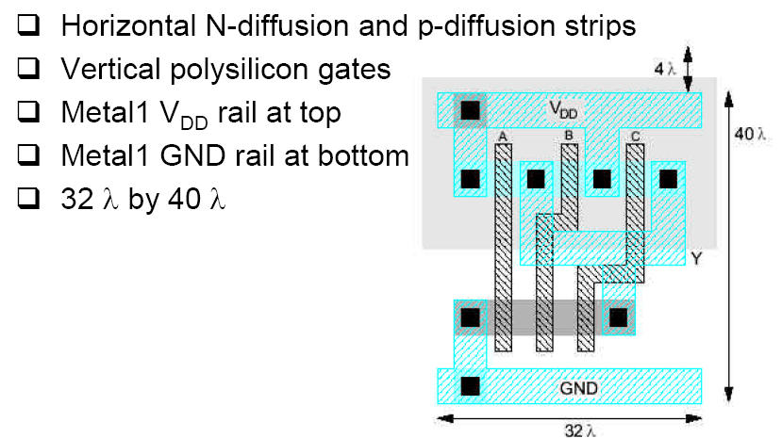
3-INPUT NAND

Slide 71
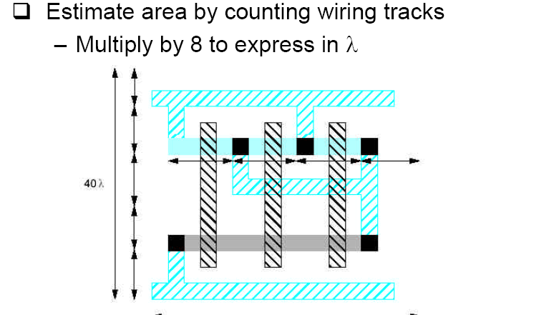
Area Estimation

Slide 72
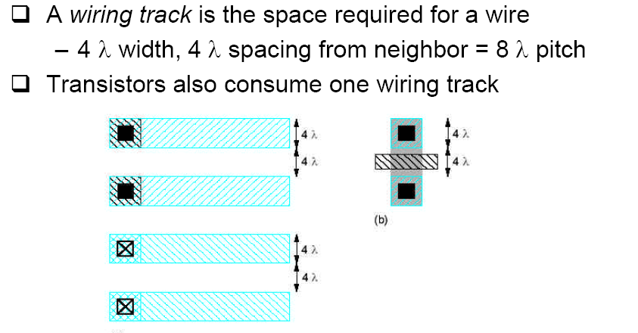
WIRING tRACK

Slide 73
Latch up of the chip page 253 Weste-harris
Short of the chip between VDD and VGND
Occurs when parasitic bipolar transistors formed by the substrate causing low resistance path
In addition to the expected nmos, pmos transistors a bipolar transistors result.
To avoid latch up minimize Resub, and Rwell
Process solution

Slide 74
Latch up

Slide 75
Sticks Diagram We will show examples
Dimensionless layout entities
Only topology is important
Final layout generated by “compaction” program

Slide 76
Summary
CMOS N-well, P-well, dual wells
Well contacts are P+ for P-well (or P-substrate), and N+ for N-well
Contacts metal to p-active, metal to n-active, metal to poly, or metal to well or substrate
Via is contact between metal layers
Well contact to the right voltage is extend to surround the well and called well guard

Slide 77
Summary
SCMOS means scalable CMOS design rules.
Lambda based design rules in the old technology
Simple and freely available, and easily migrate from one process to another
MOSIS –SCMOS rule are Lambda based

Slide 78
Summary
Technology for this class by On ( semiconductor company) 0.5 um, N-Well technology
3-metal layers, 1-2 poly layers
Lambda = 0.35micron
MOSIS rules SCMOS scale for
Lambda =1.0-------2 micron
Lambda = 0.8-----1.5 micron
Lambda = 0.35----0.5 micron

Slide 79
For the Dies connection Bonding Techniques

Slide 80
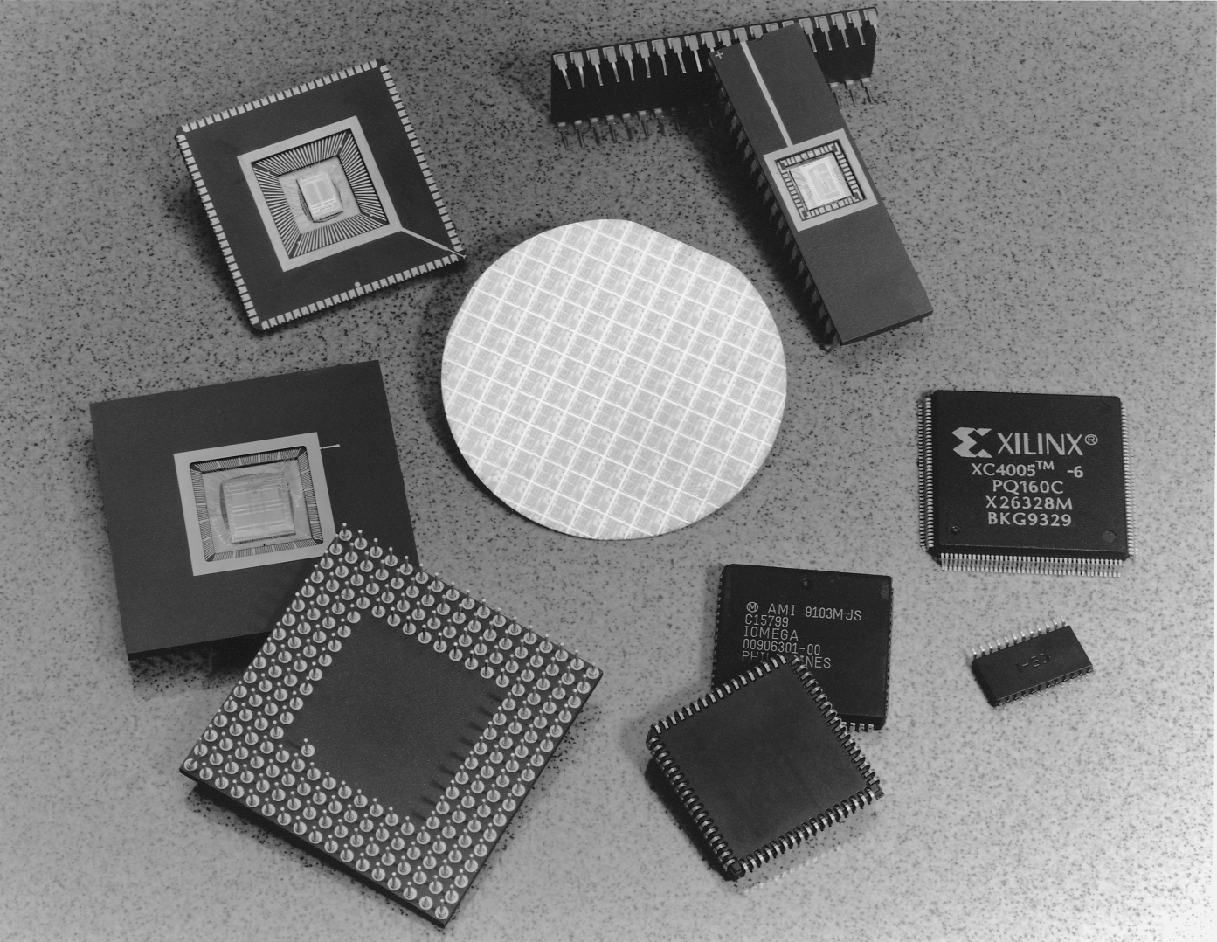
Package Types

Slide 81
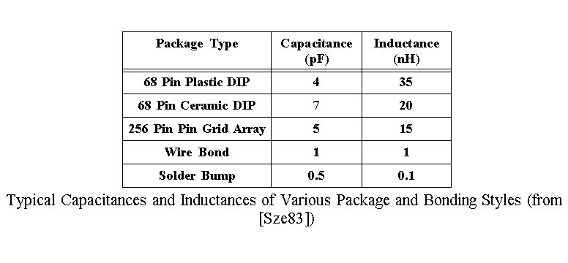
Package Parameters

Slide 82
Summary of Today Class
Fabrication steps for CMOS
CMOS layers and Design Rules
Scalable CMOS – Design Rules in chip design
Introduction to IC layout

